Slide 1
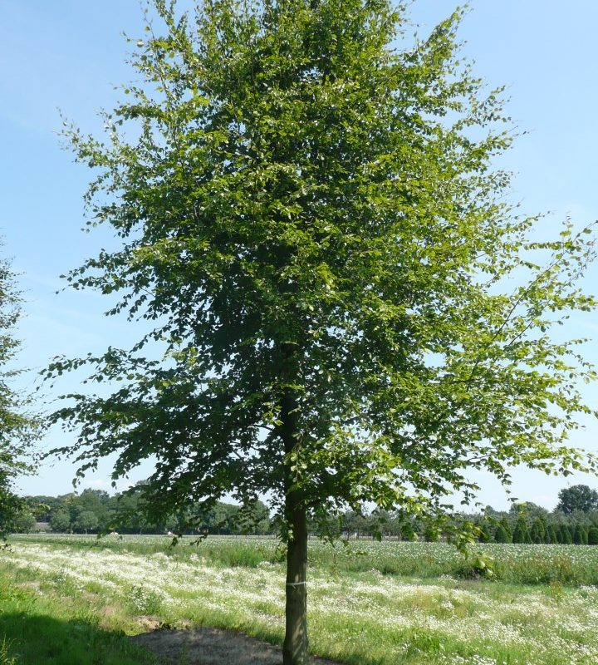
den stromů 20.10.
https://naturhelp.cz/wp-content/uploads/2020/03/Dub-zimn%C3%AD-min-3-1500x1000.jpeg
https://naturhelp.cz/wp-content/uploads/2020/03/Dub-zimn%C3%AD-min-3-1500x1000.jpeghttps://naturhelp.cz/wp-content/uploads/2020/03/Dub-zimn%C3%AD-min-3-1500x1000.jpeg

Slide 2
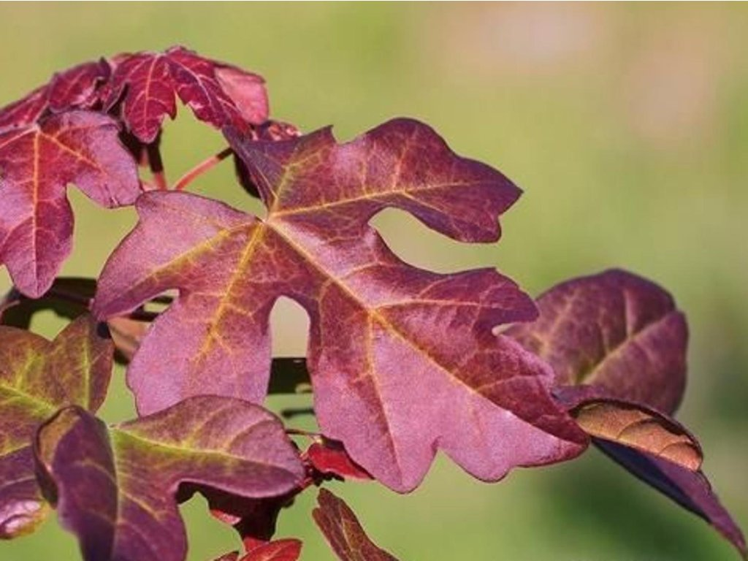
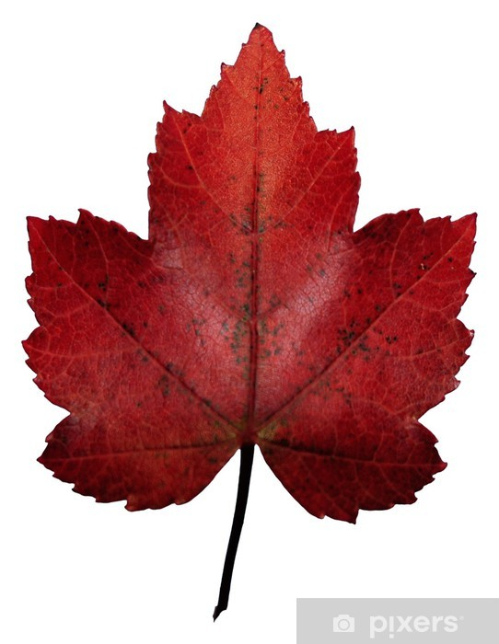
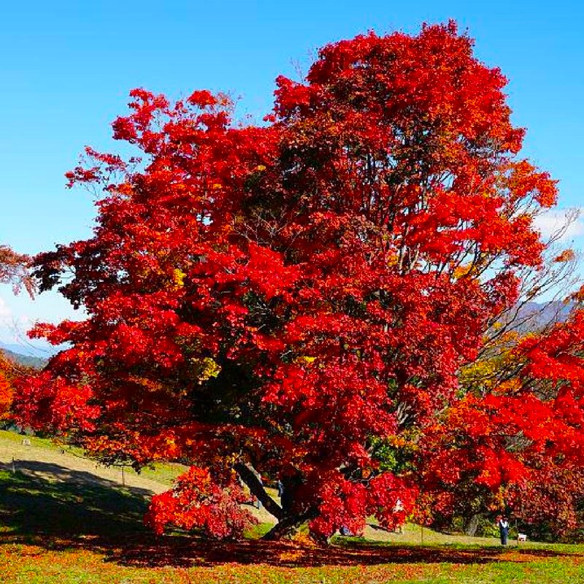
javor

